Slide 1
Applications of AI: NLP, Computer Vision, IoT (UCS655)
Unit 4: Artificial Intelligence and IoT

Slide 2
IoT
Internet
Internet of Things
Key Idea behind building an IoT system
IoT is not a single technology
Needs unification of different technologies like
Cloud technology
Big data
Machine Learning
Computer vision
Networking

Slide 3







IoT Architecture
1
2
Storage Local/Cloud
Gateway
Edge Device
n
IoT Devices
Analytics
Visualize

Slide 4
The Four Layers
Things, sensors and controllers
Sensors, actuators
Lightweight communication protocols
Gateways and data acquisition
data collection
filtering
transfer to edge infrastructure and cloud-based platforms
filter and select data to minimize the volume of information
Security
Edge Analytics
benefits especially to large-scale IoT projects
quicker response times
more flexibility in the processing and analysis of IoT data
Data Centre/Cloud Platform
store, process and analyse massive volumes of data for deeper insights
data analytics engines and machine learning mechanisms

Slide 5
Why do we need to combine AI and IoT
IoT related services follows:
Create, communicate, aggregate, analyse and act
IoT value entirely depends upon how the system acts
Intelligently
AI technology portrays a crucial role
IoT is producing huge silos of data and we need to process this data intelligently

Slide 6
Benefits of combining AI and IoT
Improved customer Experience
Connected Intelligence
Real-time monitoring and actions
Enhanced risk management
New products and services
Eliminates costly unexpected downtime

Slide 7
Example of AI and IoT in Action
AI empowered IoT systems
Robots in manufacturing
Retail analytics
Self-driving cars
Smart thermostat solution
Smart buildings

Slide 8
Role of blockchain and AI in Intelligent IoT
Convergence of Blockchain, IoT and AI
Blockchain – transparency, trust and security
IoT – Automatization
AI – improve quality of service
Blockchain-enabled Intelligent IoT architecture

Slide 9
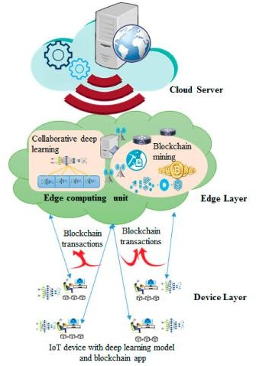
Intelligent IoT Architecture
Source: S. Rathore, Y. Pan, J.H. Park, BlockDeepNet: A Blockchain- based Secure Deep Learning for IoT Network, Sustainability 11, 2019.

Slide 10
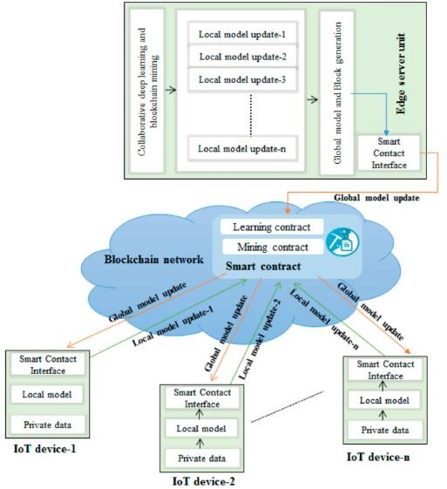
Functional Components
Source: S. Rathore, Y. Pan, J.H. Park, BlockDeepNet: A Blockchain- based Secure Deep Learning for IoT Network, Sustainability 11, 2019.

Slide 11
Use case: Smart Cities
Smart City
Use ICT (sensors, sensor networks, actuators, RFID etc.)
Makes regular infrastructure more accessible and interactive
Why do we need smart city?

Slide 12
Key Application Areas of Smart City
Smart Governance
Smart Economy
Smart People
Smart Mobility
Smart Environment
Smart Living

Slide 13
Current Focus Areas
Smart Homes
Smart Vehicles
Smart Health
Pollution and crisis monitoring
Smart Energy

Slide 14
Challenges in Building Smart Cities
Security and Privacy
Heterogeneity
Scalability
Reliability
Big Data Analysis

Slide 15
Data Fusion
Enables optimum utilization of massive data gathered from multiple sources across multiple platforms
Stages
Decision Level
Feature Level
Pixel Level
Signal Level
Mathematical models for data fusion
Probability-based methods
Bayesian Analysis, statistics
AI-based Methods
Machine Learning, ANN, Deep Learning, CNN
Theory of Evidence based Methods
Belief functions

Slide 16
Role of AI in IoT Decision Making
AI is a big helper in enabling IoT systems
Highly accurate decision making

Slide 17
Use Case: Smart Energy Grid
Traditional Energy Grid
Centralized
Unidirectional distribution of energy
Monitoring and maintenance are usually done manually
Smart Energy Grid
Use ICT to make the reliable power system
Cyber-physical System
Bidirectional

Slide 18
Smart Grid
Definition by NIST:
A smart grid is a modernized grid that enables bidirectional flows of energy and uses two-way communication and control capabilities that will lead to an array of new functionalities and applications

Slide 19
Benefits of Smart Grid
Better integration of customer-owner power generation systems
Improved security
Efficient transmission, quicker restoration and reduced cost
Identify peak demand

Slide 20
Benefits to Customers
Program their smart appliances to run during off-peak hours to lower their bills
Updated information on energy usage in real time
Enjoy different pricing options

Slide 21
Properties of a Smart Grid
Customer participation
Real-time pricing
Distributed generation
Power system efficiency
Power quality

Slide 22
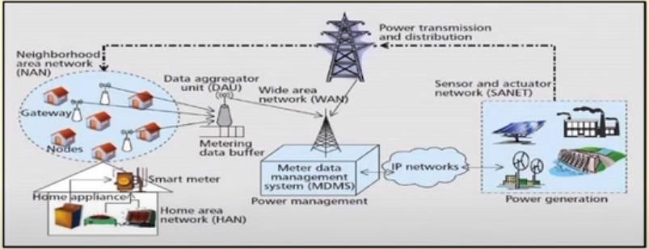
Architecture of a Smart Grid
Source: D. Niyato and P. Wang, IEEE CM, 2012.

Slide 23
Smart Grid Communication
Energy flow and information flow
Components of communication
Smart home appliances
Smart Meters
Gateways
Data aggregation units (DAUs)
Meter Data Management Systems (MDMS)
Networks associated with communication
Home area network (HAN)
Neighborhood area network (NAN)
Wide area network (WAN)
IP network
Sensor and Actuator Network (SANET)

Slide 24
Components of Smart Grid
Smart home
Smart metering
Smart appliances
Home power generation system
Consumer engagement
Time-of-use pricing
Financial incentives
Operation Centre
Monitoring and controlling transmission systems
Phasor measurement units (PMUs) – dynamic energy distribution
Collection of PMUs – Phasor network
Phasor network fed information further to SCADA (Supervisory Control & Data Acquisition)
Distribution Intelligence

Slide 25
Smart Grid Security
Integrity
Availability
Physical Threats

Slide 26
Collaborating Cloud Technology with Smart Grid
Energy Management
Information Management
Security

